Slide 1
Evaluation for Linear Regression
~ Meet Nagadia

Slide 2
Why need for Evaluation ?
Model evaluation is very important since we need to understand how well our model is performing.
In comparison to classification, performance of a regression model is slightly harder to determine because, unlike classification, it is almost impossible to predict the exact value of a target variable.
Therefore, we need a way to calculate how close our prediction value is to the real value.
There are different model evaluation metrics that are used popularly for regression models which we are going to dive into in the following sections.

Slide 3
Evaluations Metric for Regression:
Mean Absolute Error(MAE)
Mean Squared Error(MSE)
RMSE
RMSLE
R squared
Adjusted R Squares

Slide 4
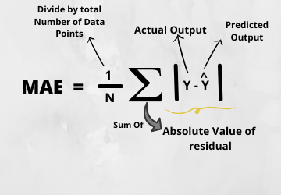
Mean Absolute Error (MAE)
MAE is a very simple metric which calculates the absolute difference between actual and predicted values.
To better understand, let’s take an example you have input data and output data and use Linear Regression, which draws a best-fit line.
Now you have to find the MAE of your model which is basically a mistake made by the model known as an error.
Now find the difference between the actual value and predicted value that is an absolute error but we have to find the mean absolute of the complete column.
So, sum all the errors and divide them by a total number of observations And this is MAE.
And we aim to get a minimum MAE because this is a loss.
Sklearn Module MAE

Slide 5
Mean Absolute Error (MAE)
Advantages
Disadvantages
The MAE you get is in the same unit as the output variable.
It is most Robust to outliers.
The graph of MAE is not differentiable so we have to apply various optimizers like Gradient descent which can be differentiable.

Slide 6
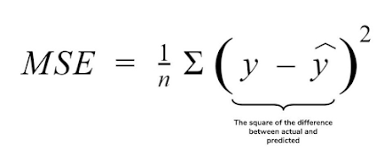
Mean Squared Error(MSE)
MSE is a most used and very simple metric with a little bit of change in mean absolute error. Mean squared error states that finding the squared difference between actual and predicted value.
So, above we are finding the absolute difference and here we are finding the squared difference.
What actually the MSE represents? It represents the squared distance between actual and predicted values. we perform squared to avoid the cancellation of negative terms and it is the benefit of MSE.
Sklearn Module MSE

Slide 7
Mean Squared Error (MSE)
Advantages
Disadvantages
The graph of MSE is differentiable, so you can easily use it as a loss function.
The value you get after calculating MSE is a squared unit of output. for example, the output variable is in meter(m) then after calculating MSE the output we get is in meter squared.
If you have outliers in the dataset then it penalizes the outliers most and the calculated MSE is bigger. So, in short, It is not Robust to outliers which were an advantage in MAE.

Slide 8
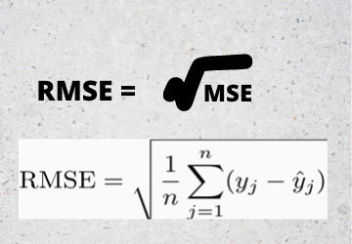
Root Mean Squared Error(RMSE)
As RMSE is clear by the name itself, that it is a simple square root of mean squared error.
Sklearn RMSE

Slide 9
Root Mean Square Error
Advantages
Disadvantages
The output value you get is in the same unit as the required output variable which makes interpretation of loss easy.
It is not that robust to outliers as compared to MAE.
Note: Most of the time people use RMSE as an evaluation metric when they are working with deep learning techniques.

Slide 10
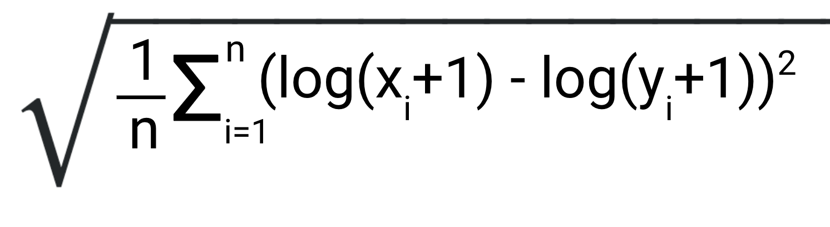
Root Mean Squared Log Error(RMSLE)
Taking the log of the RMSE metric slows down the scale of error. The metric is very helpful when you are developing a model without calling the inputs. In that case, the output will vary on a large scale.
To control this situation of RMSE we take the log of calculated RMSE error and resultant we get as RMSLE.
Sklearn RMSLE

Slide 11
Root Mean Squared Log Error (RMSLE)
Advantage
Disadvantage
Treats small differences between small actual and predicted values same as big differences between large actual and predicted values.
Penalizes underestimates more than the overestimates

Slide 12
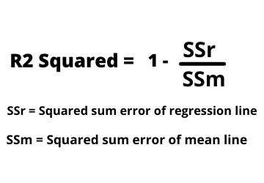
R Squared (R2)
R2 score is a metric that tells the performance of your model, not the loss in an absolute sense that how many wells did your model perform.
In contrast, MAE and MSE depend on the context as we have seen whereas the R2 score is independent of context.
So, with help of R squared we have a baseline model to compare a model which none of the other metrics provides. The same we have in classification problems which we call a threshold which is fixed at 0.5. So basically R2 squared calculates how must regression line is better than a mean line.
Hence, R2 squared is also known as Coefficient of Determination or sometimes also known as Goodness of fit.
Sklearn R Squared

Slide 13
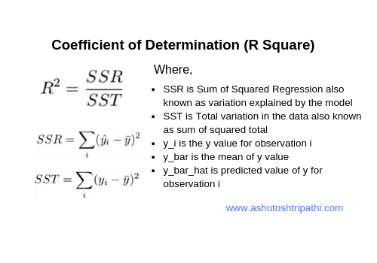
R Squared (R2)
Now, how will you interpret the R2 score?
Suppose If the R2 score is zero then the above regression line by mean line is equal means 1 so 1-1 is zero. So, in this case, both lines are overlapping means model performance is worst, It is not capable to take advantage of the output column.
Now the second case is when the R2 score is 1, it means when the division term is zero and it will happen when the regression line does not make any mistake, it is perfect. In the real world, it is not possible.
So we can conclude that as our regression line moves towards perfection, R2 score move towards one. And the model performance improves.

Slide 14
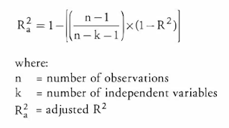
Adjusted R squared
The disadvantage of the R2 score is while adding new features in data the R2 score starts increasing or remains constant but it never decreases because It assumes that while adding more data variance of data increases.
But the problem is when we add an irrelevant feature in the dataset then at that time R2 sometimes starts increasing which is incorrect.
Hence, To control this situation Adjusted R Squared came into existence.
Sklearn R Squared

Slide 15
Adjusted R Squared
Now as K increases by adding some features so the denominator will decrease, n-1 will remain constant. R2 score will remain constant or will increase slightly so the complete answer will increase and when we subtract this from one then the resultant score will decrease. so this is the case when we add an irrelevant feature in the dataset.
And if we add a relevant feature then the R2 score will increase and 1-R2 will decrease heavily and the denominator will also decrease so the complete term decreases, and on subtracting from one the score increases.

Slide 16
Resources:
Stack exchange
Analytics Vidhya
Machinelearningmastery
Towardsdatascience

